Slide 1
COMP 286 Java II-Data Structures
Chapter 3
A Bag Implementation That Links Data

Slide 2
A Linked List
Now we will implement the bag using a linked list
Each item points to the next item
  The items are called nodes
  We also need a pointer to the first node
One field in the class definition is the name of the class!
  This is the link (a “pointer”) to the next node
    It’s called a reference

Slide 3
A Node in a Linked List-Sample Code
class Node
{
private T data;
private Node nextNode;
}

Slide 4

A Picture of a Linked List

Slide 5
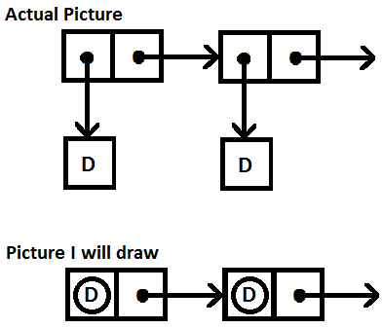
Pictures Aren’t Reality Version 1

Slide 6
Pictures Aren’t Reality! Version 2
There is no such (physical) thing as a linked list in a program
It is an idea
There is one node that is the first node in the list
  That’s the only thing in the program
The next node is linked to it
  The next node is linked to that node, etc.

Slide 7
Methods
The real world item we are modeling is a bag
So, we will use the same methods we did before
Wait! We can reuse the same interface?
ABSOLUTELY!
All we have to do is create new implementation

Slide 8
A Look at the Methods
When we used an array, we added and deleted items from the end of the array
Now, we will add and delete items from the beginning (head) of the list
  Why?
Does it matter?
Let’s look at adding and deleting

Slide 9
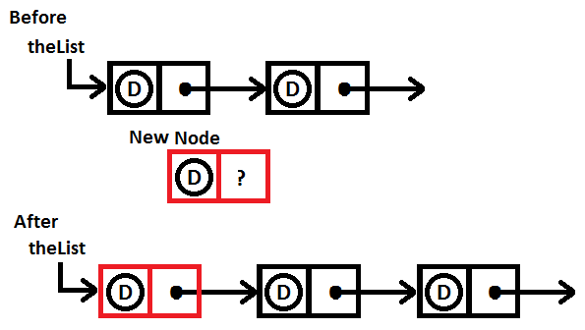
Adding a Node at the Start of the Chain

Slide 10
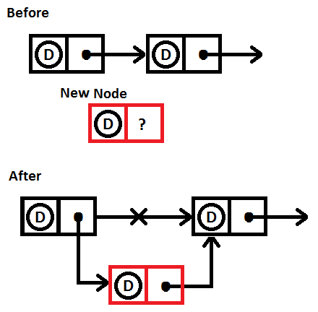
Adding a Node in the Middle of the Chain

Slide 11
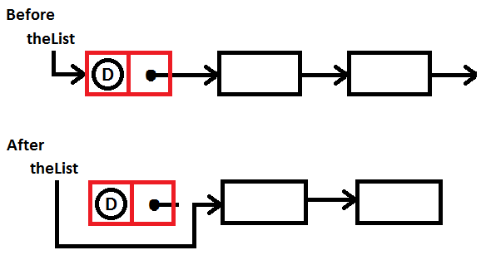
Removing a Node from the Start of the Chain

Slide 12
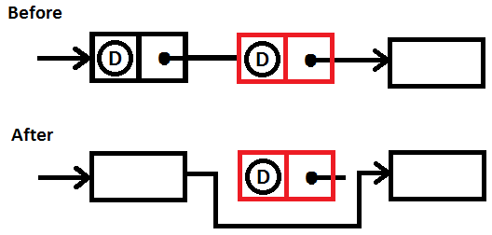
Removing a Node from the Middle of a Chain

Slide 13
A Problem
We have a problem
We want users to be able to access the data in the program, so we consider providing get and set methods for nodes
On the other hand, using a linked list for the bag is a design detail, and the user should not know this

Slide 14
The Solution
The solution is to use nested classes
The inside class will be called the inner class
The inner class does not need <T> because it’s already there for the outer class
  The inner class can access the <T> for the outer class, if necessary

Slide 15
The Inner Class for a Node-The Instance Variables
private class Node
{
private T data;
private Node next;

Slide 16
The Inner Class for a Node-Constructors
private Node (T dataPortion)
{
this (dataPortion, null);
}
private Node (T dataPortion, Node nextNode)
{
data = dataPortion;
next = nextNode;
}

Slide 17
The Full LinkedBag Class Showing the Inner Class
public final class LinkedBag<T> implements BagInterface<T>
{
// Instance variables
// Constructors
// Other methods
private class Node
{
… // The inner class (Node)
}
} // end LinkedBag

Slide 18
Creating Nodes and Building a Linked List
To create a node, we just instantiate it
  Node tempNode = new Node (“Data”);
Now create a second node
  Node newNode = new Node (“More Data”);
Now link newNode after tempNode
  tempNode.next = newNode;
You can also create a node and link another node directly after it in one step

Slide 19
Adding and Removing Nodes from a Linked List
Think of the shopping bag
If it were an actual shopping bag, we might
  Add items
  Delete items
We will look at code to do that

Slide 20
Adding a Node at the Beginning of the Chain
First, we put data into the node
  Node newNode = new Node (newData);
There are two cases
Case 1. The chain is empty
  firstNode = newNode;
Case 2. The chain has nodes in it
  newNode.next = firstNode;
  firstNode = newNode;

Slide 21
Combining the Two Cases
The two cases can be combined by noticing that firstNode is null if there are no nodes in the list
  That makes the line
    newNode.next = firstNode;
  work in both cases
So, all we have to code is
  Node newNode = new Node (newEntry);
  newNode.next = firstNode;
  firstNode = newNode;
This will work for both cases

Slide 22
Allocating Memory
When you instantiate a node, we sometimes refer to this as allocating memory
  Actually, instantiating anything allocates memory for it

Slide 23
Traversing the Linked List
Oftentimes, we will need to process every node in the list
  Perhaps we are searching for an item
We use this code
Node currentNode = firstNode;
while (currentNode != null)
{
… // Code to process one node in the list
currentNode = currentNode.next;
} // end while
You should memorize this code

Slide 24
A Test Program
We code toArray and isEmpty
isEmpty is easy
We code toArray so we can test
It’s common to have toString as well
See LinkedBagDemo1 for code to test the initial parts of our class

Slide 25
Removing an Unspecified Node
This is easy because we have a linked list
We simply remove the first node in the list
T result = null;
if (firstNode != null)
{
result = firstNode.data;
firstNode = firstNode.next; // Remove first node
numberOfEntries--;
}
return result;

Slide 26
The Rest of the Code
We code the rest of the methods, essentially the same as before

Slide 27
Lab 3-Linked Lists
Do Lab 3 as described in the lab document
You will have to create a linked list
It should have at least 9 nodes in it
Manipulate the list as described in the lab document
This means
  Adding items,
  Deleting items, and
  Printing the list.

Slide 28
Details
For full credit
You must submit the class to Canvas
  It must be a text file
  It cannot be a pdf, jpg, etc., file
You must also submit a design document

Slide 29
Academic Honesty
Again, I remind you of our academic honesty policy:
All programs must be written by you alone.

Slide 30
Checking that Policy
Other than getting code from the text or me, if a program is not completely your own work, you will receive a zero (0) for it
The phrase “your own work” means
That you wrote the program yourself
That you wrote it without coding help from anyone except me
That you did not download the program or any part of it from the internet

